Slide 1
Classic Cars Price Prediction
Alisha Thomas :C0872330
Aswathy Anilkumar :C0896280
Jasmin Joseph :C0897352
Niral Shah :C0894470
Sudhy Sukumaran :C0891288

Slide 2
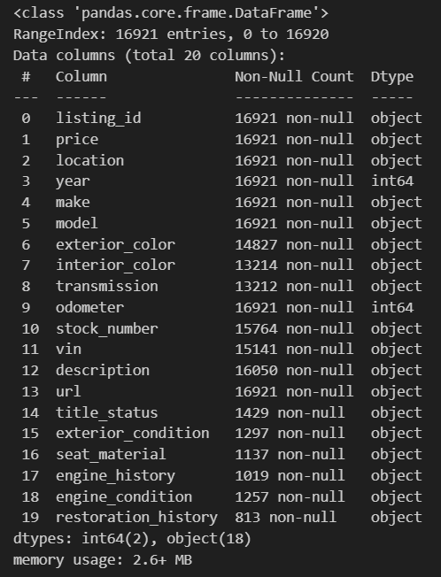
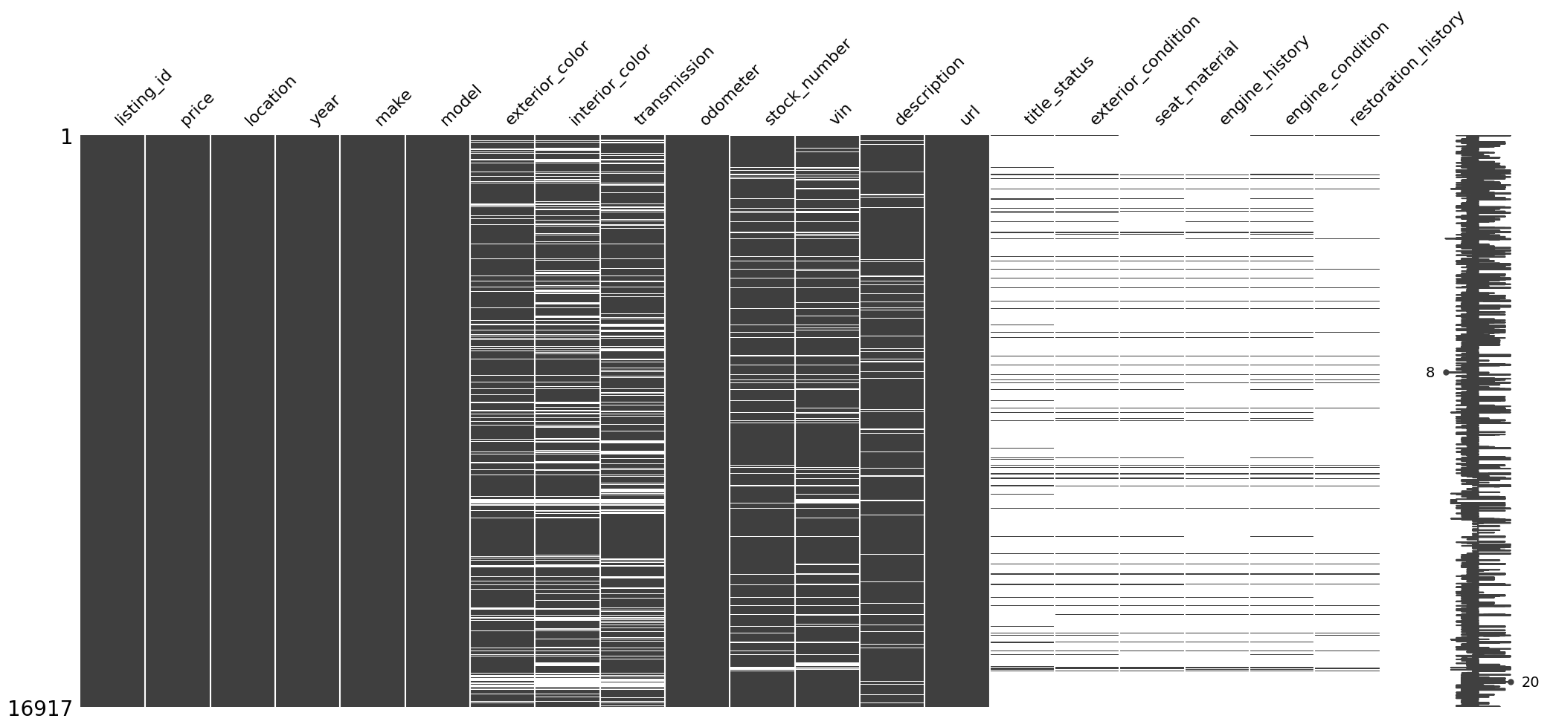
Data Exploration

Slide 3
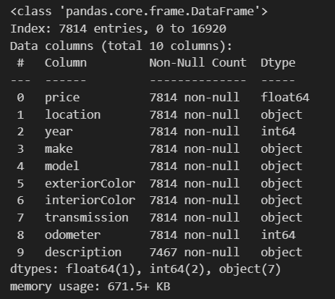
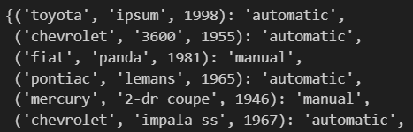
Preprocessing

Slide 4
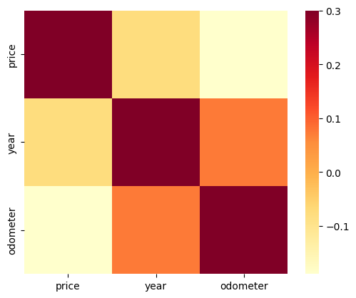
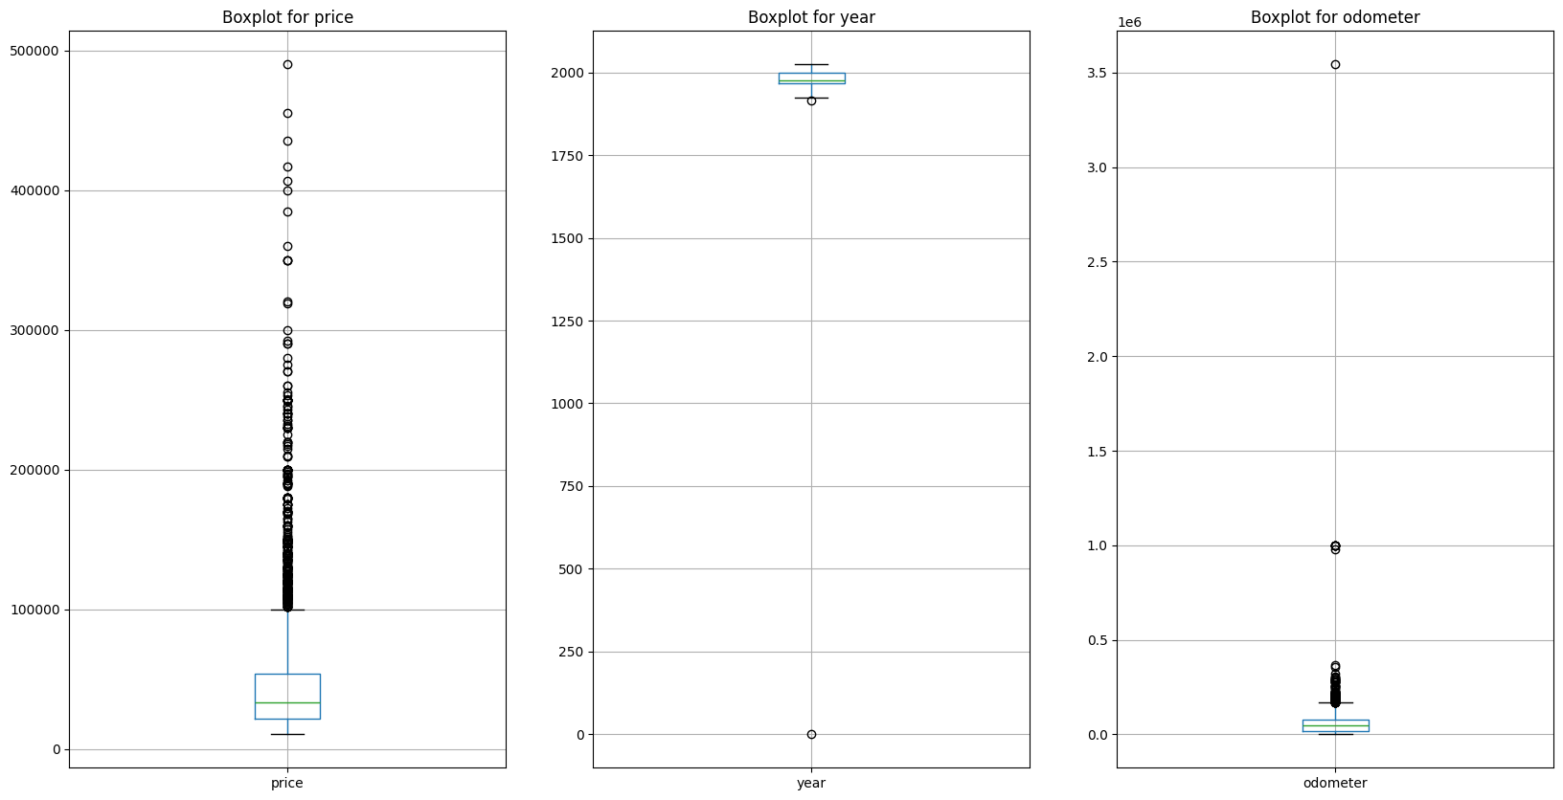
Preprocessing & Visualization
Categorical Encoding
One Hot Encoding
Outlier Detection
Quantile based flooring and capping

Slide 5
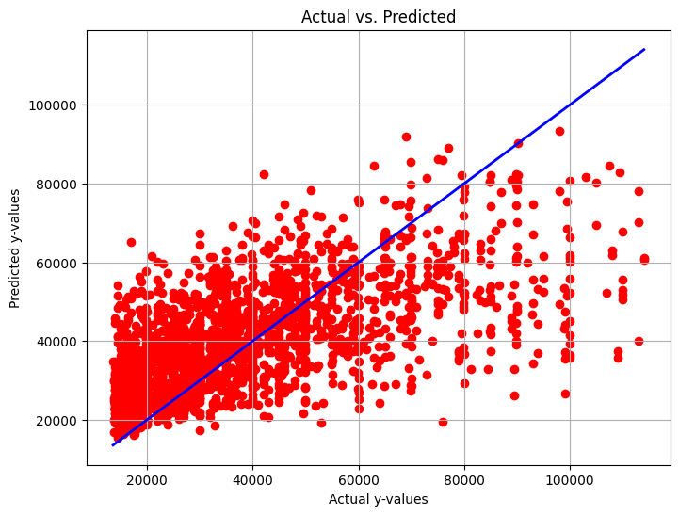

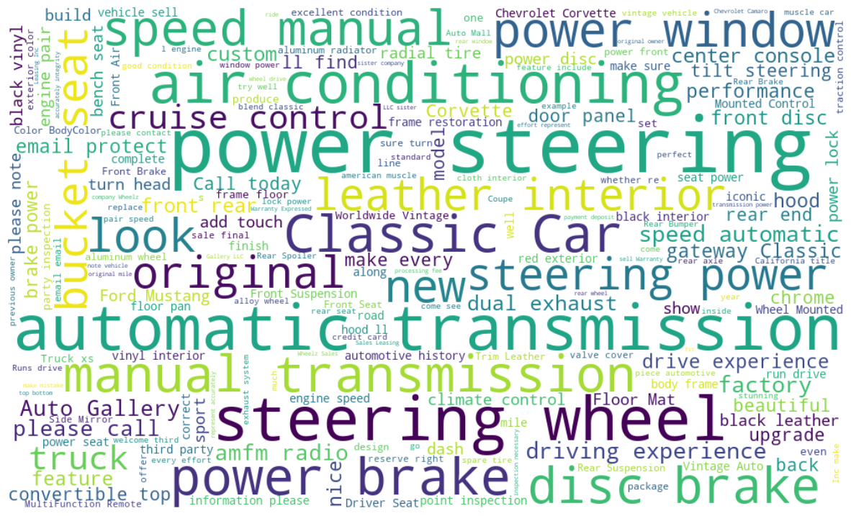
Modelling and NLP
Linear Regression
Random Forest Regression
Polynomial Regression
Hyperparameter Tuning
-Grid Search
K-fold Cross Validation
NLP

Slide 6
Conclusion
Best model - Random Forest Regression
Thank You

